Slide 1
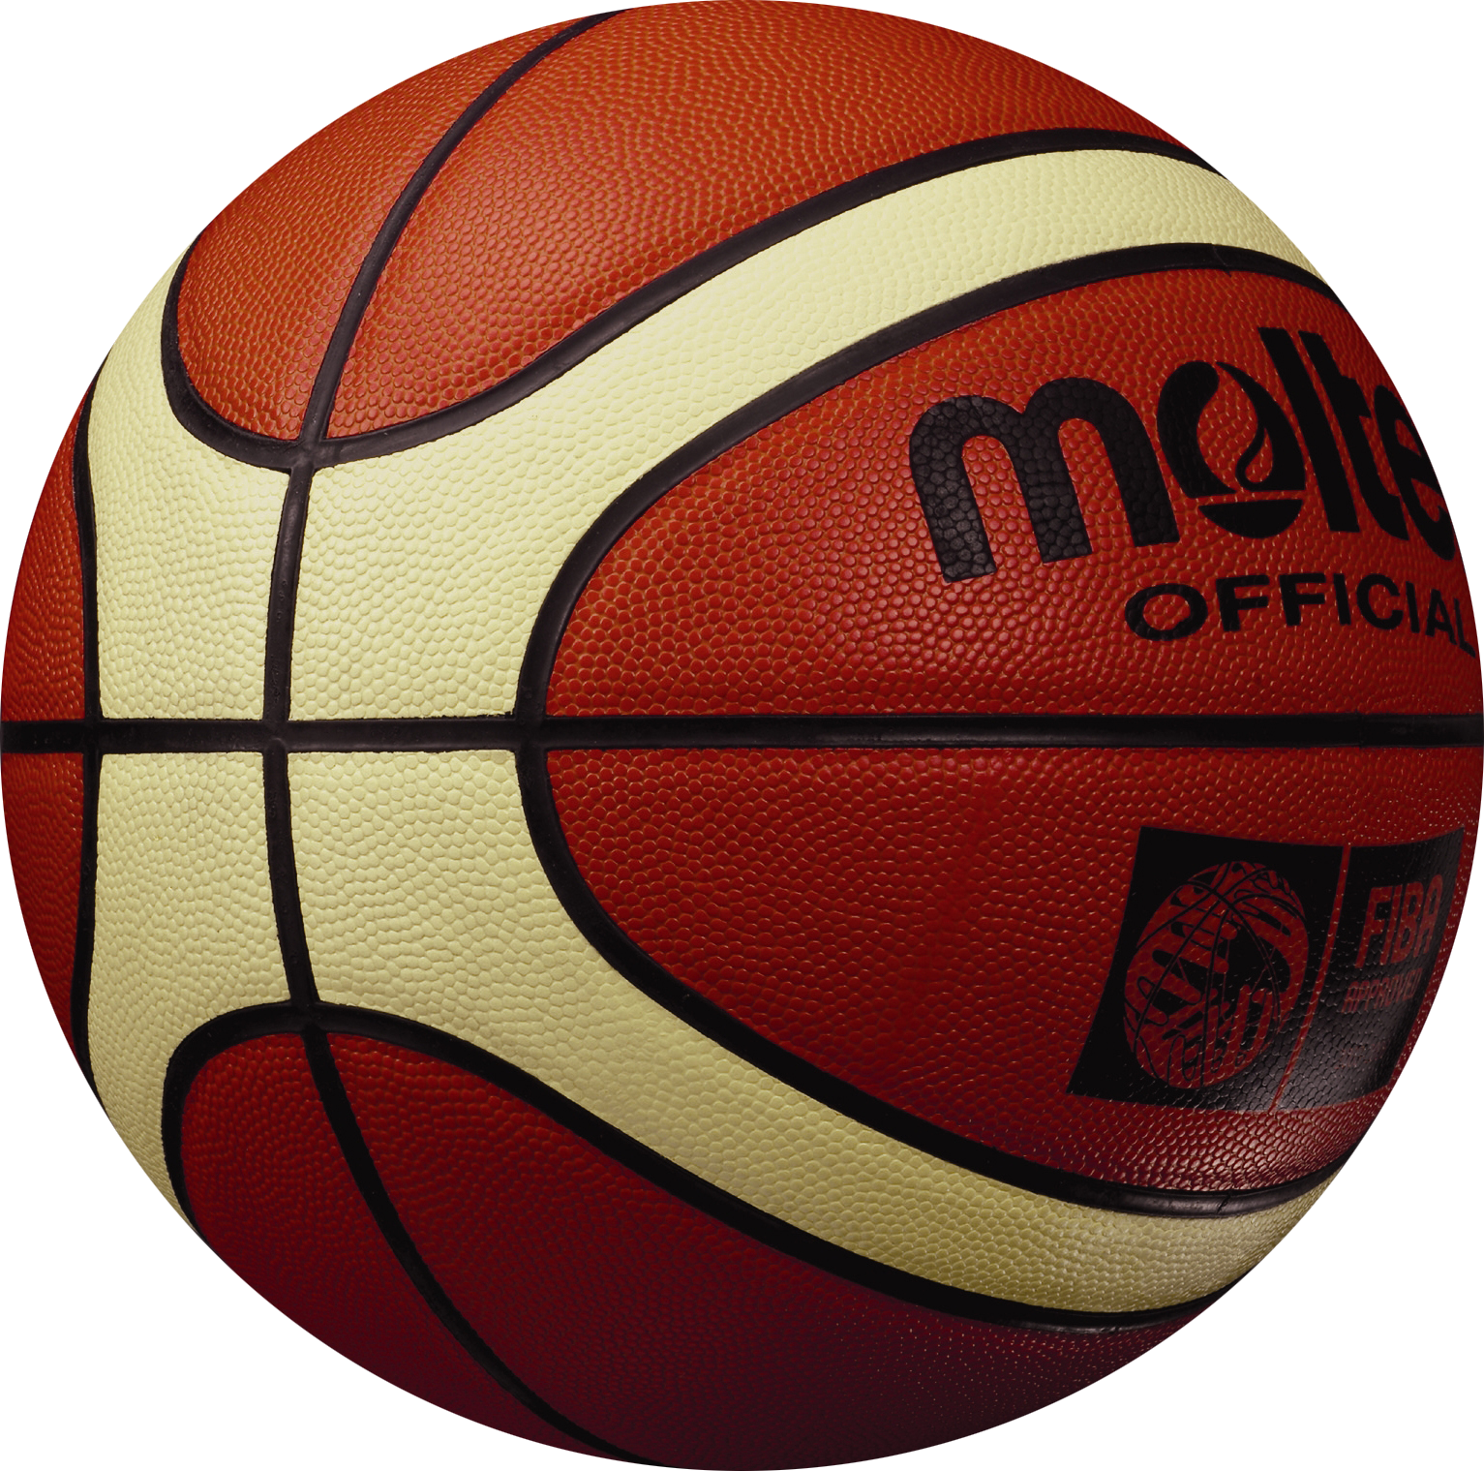
Practice
makes perfect
Karl Southern

Slide 2
“We are more limited by our beliefs than by our abilities”
Dr. Tom Amberry
(Retired podiatrist)

Slide 3
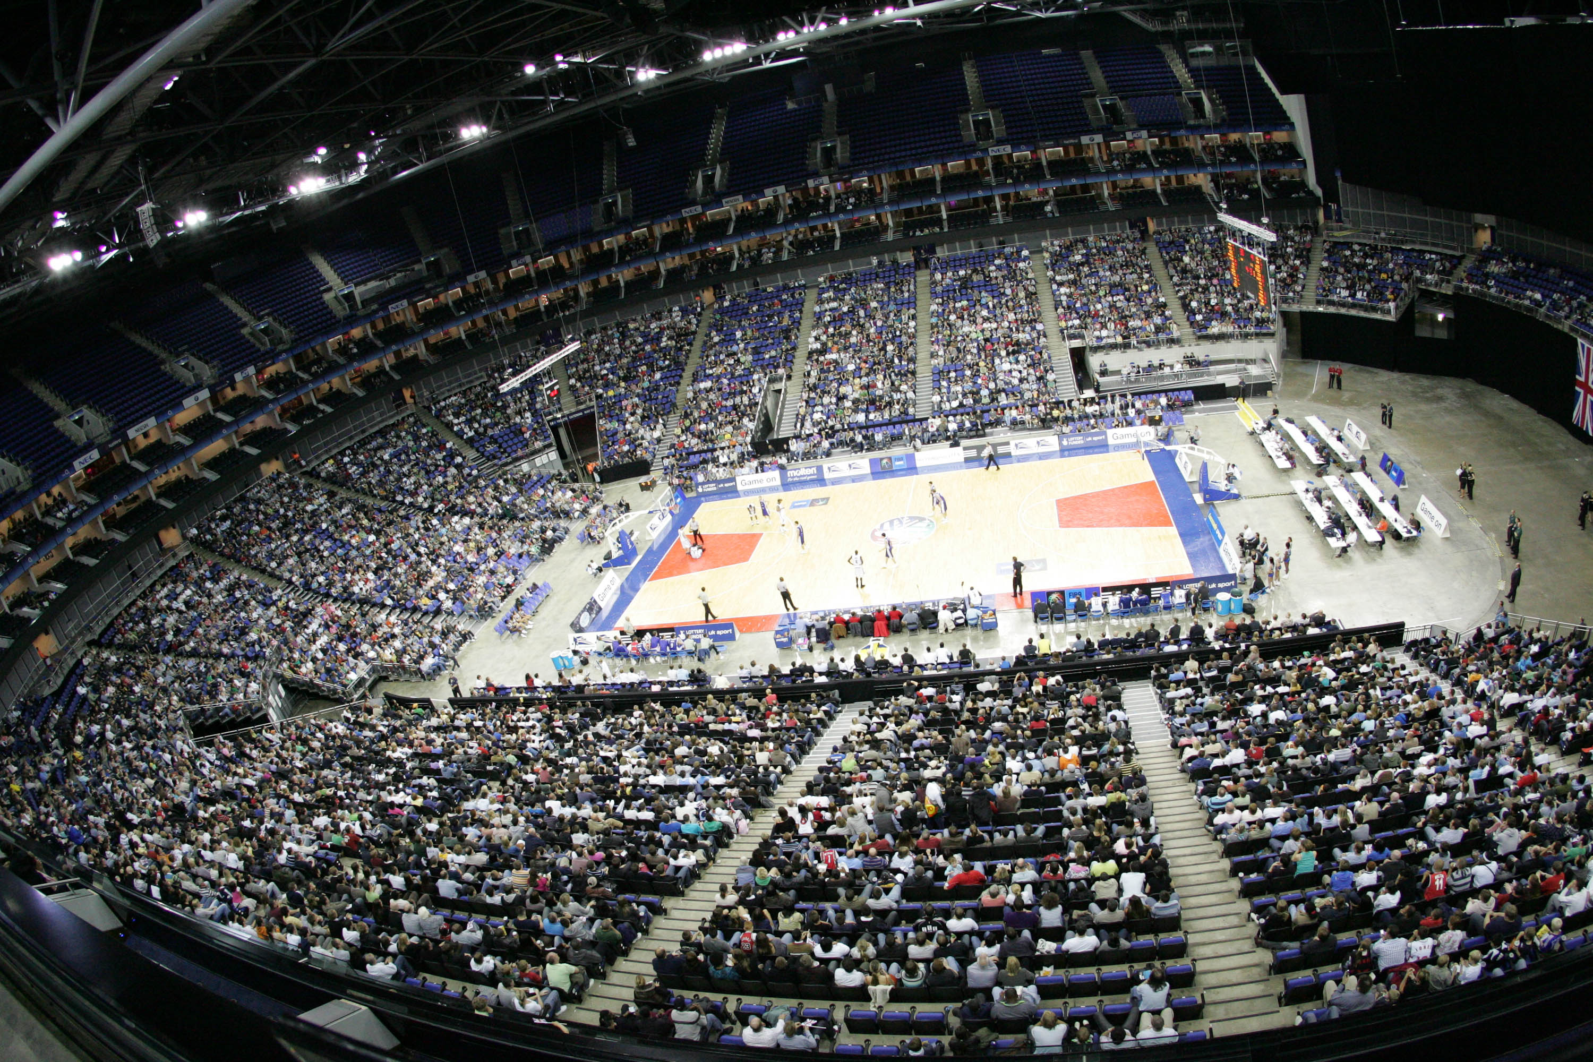

Slide 4
18 feet
10 feet
15 feet

Slide 5

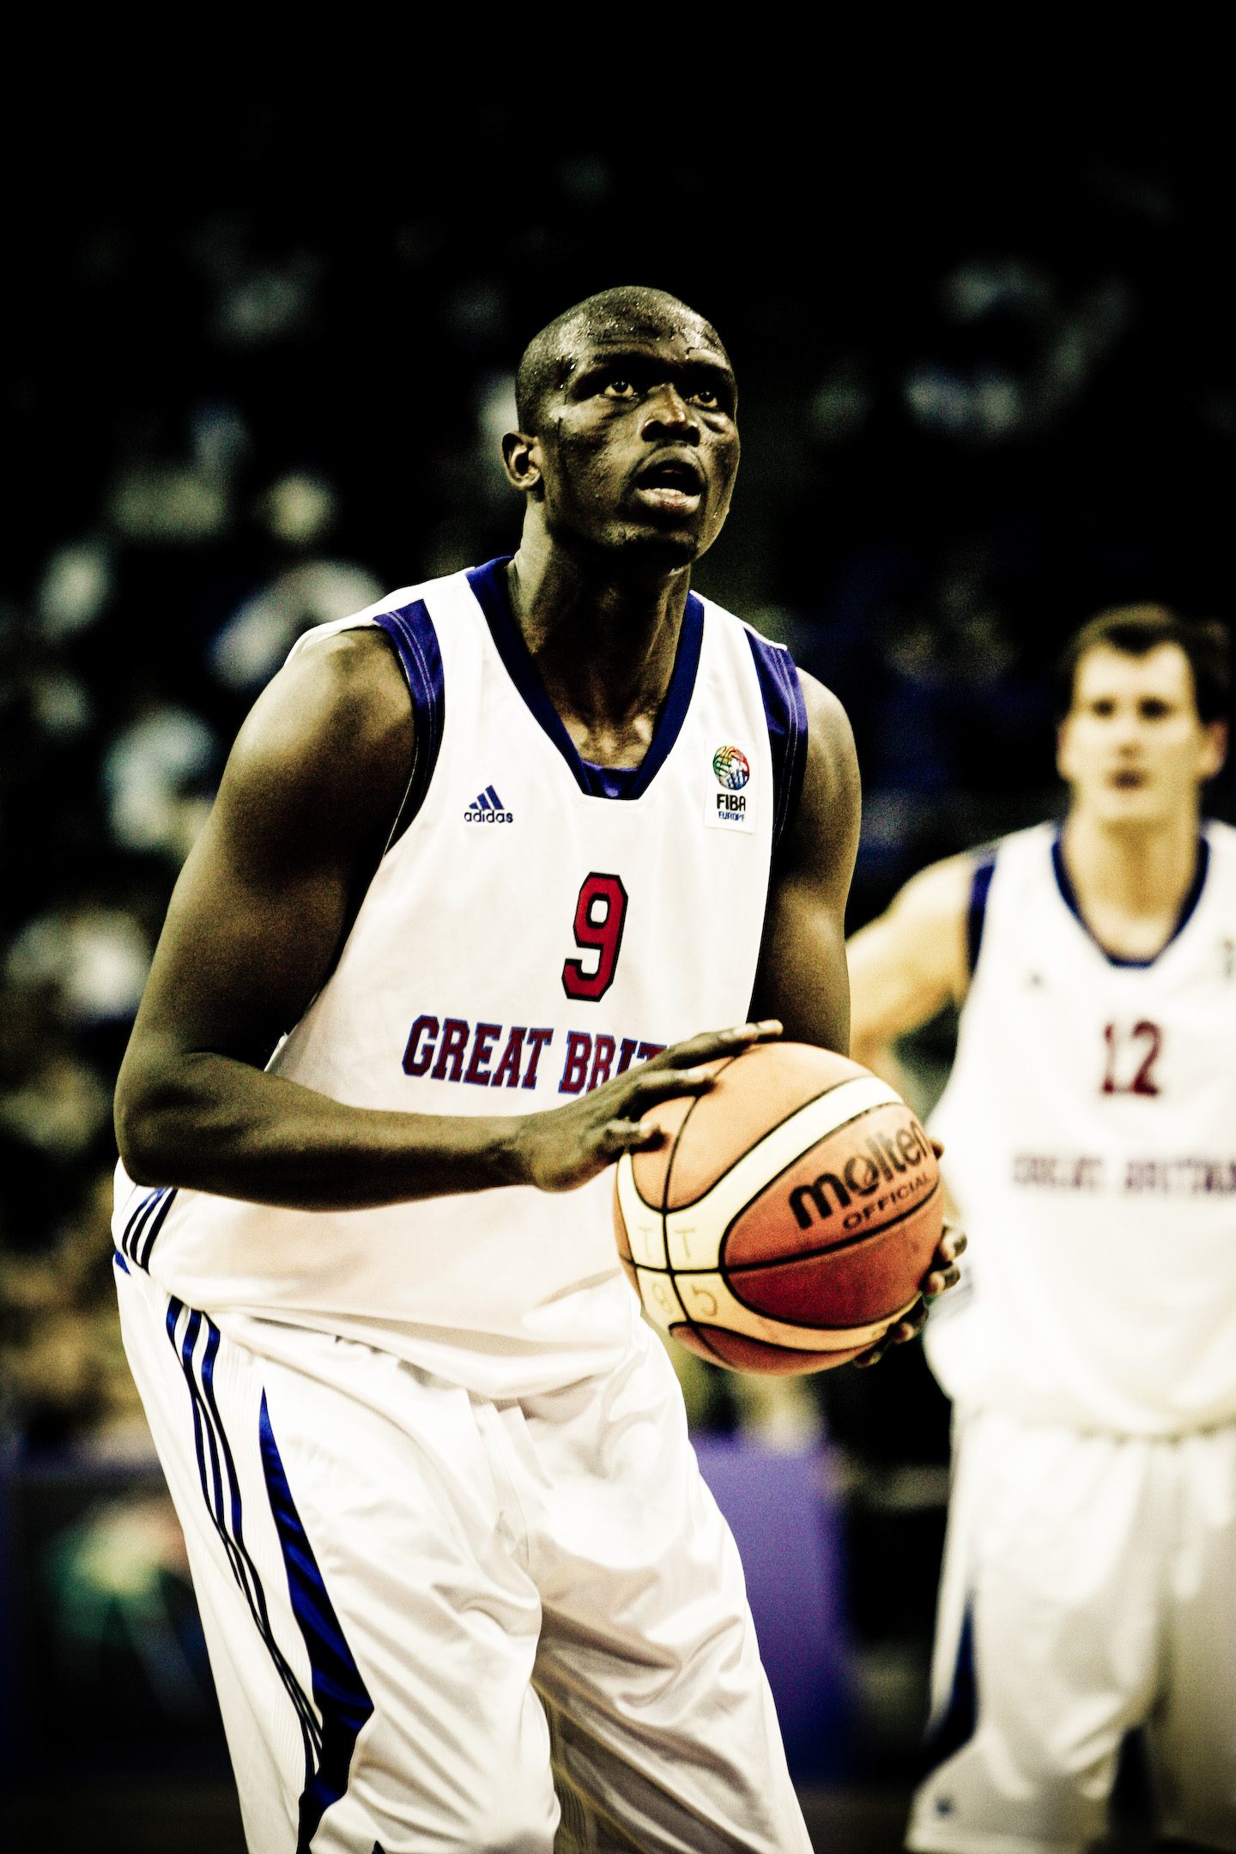

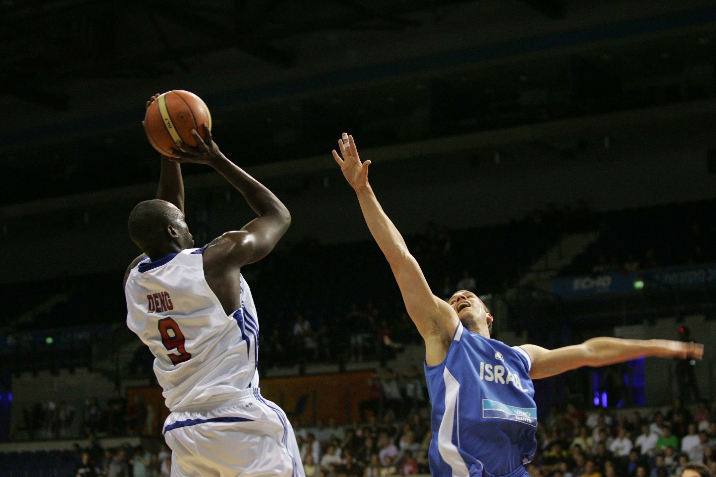
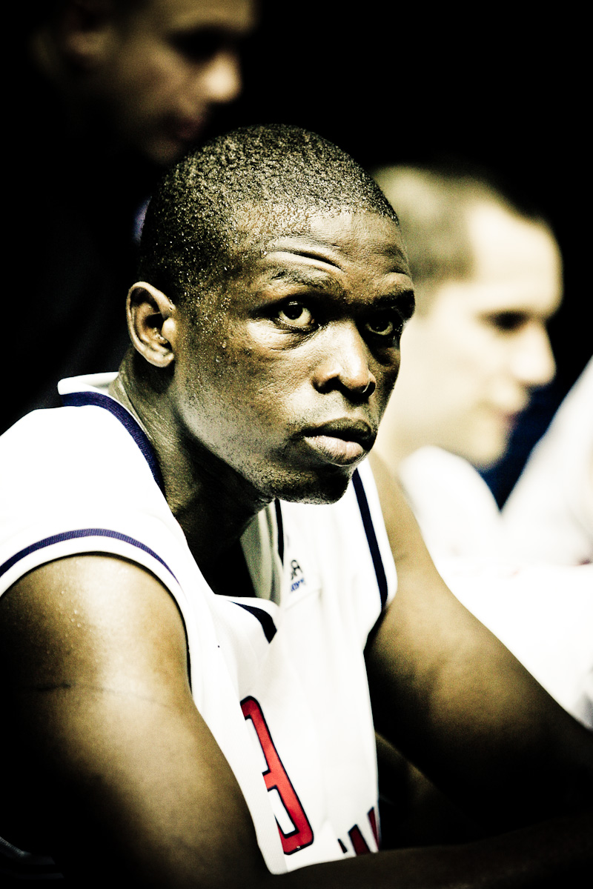
Luol Deng

Slide 6
Luol Deng
Took: 336
Made: 253
75%

Slide 7
What is the world record for consecutive successful
free throws?

Slide 8
2750

Slide 9
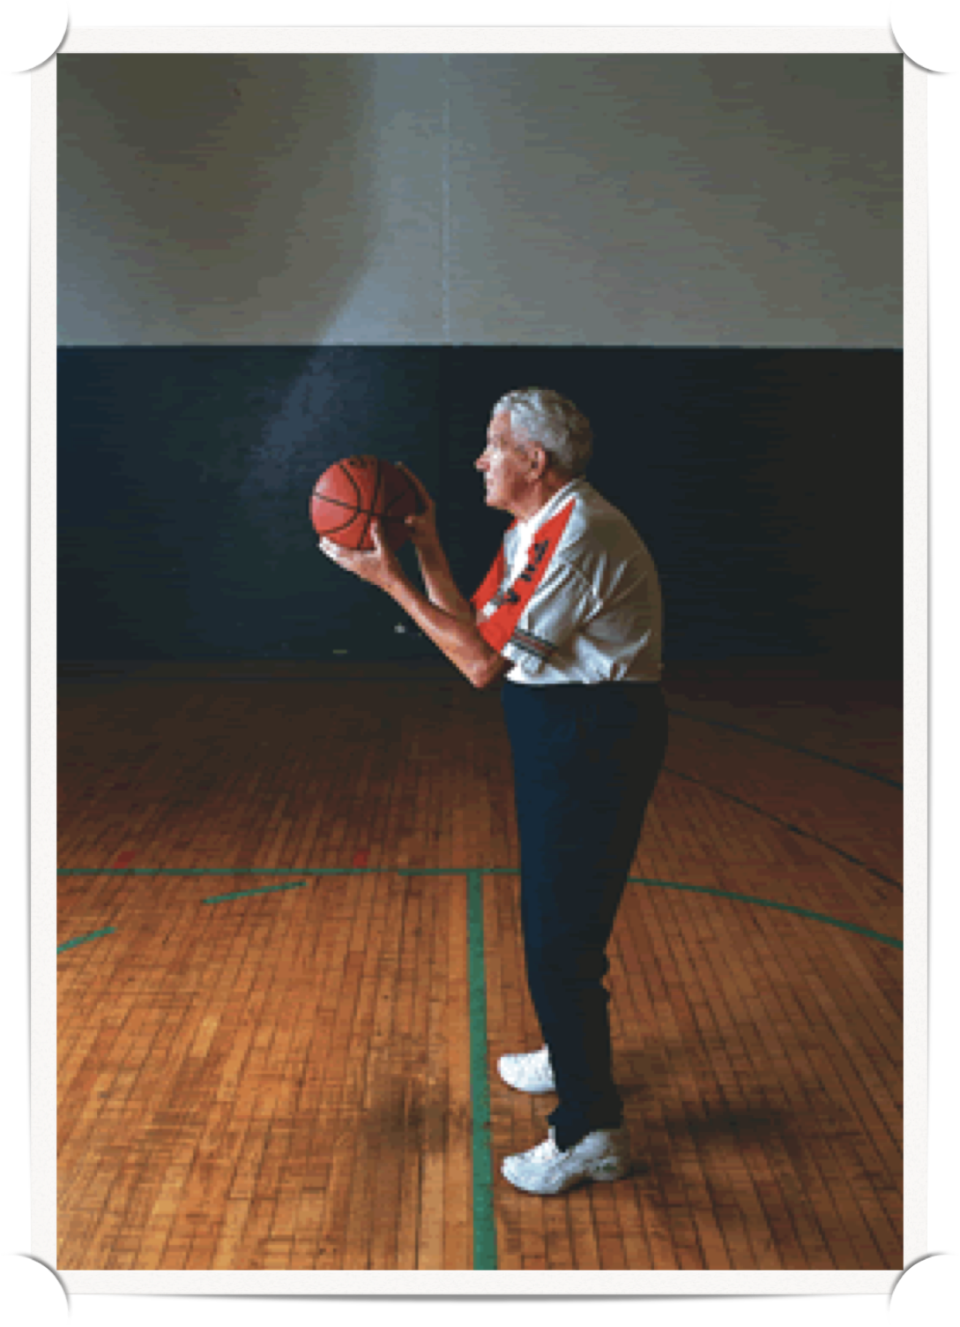
Dr. Tom Amberry
(Retired podiatrist)
“We are more limited by our beliefs than by our abilities”

Slide 10
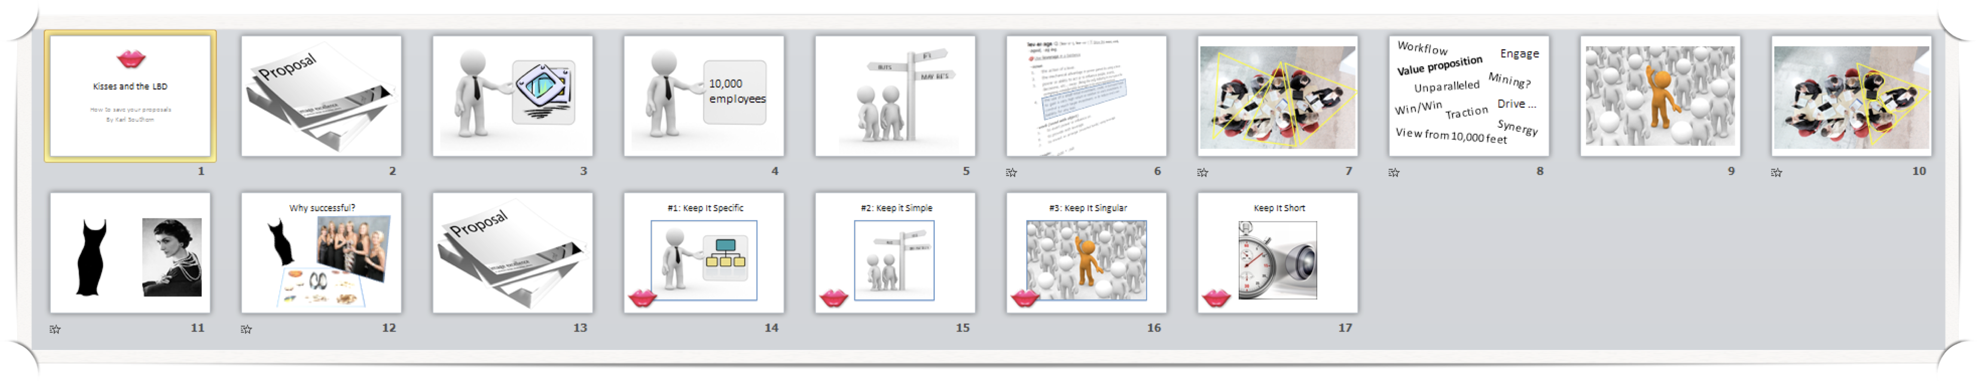
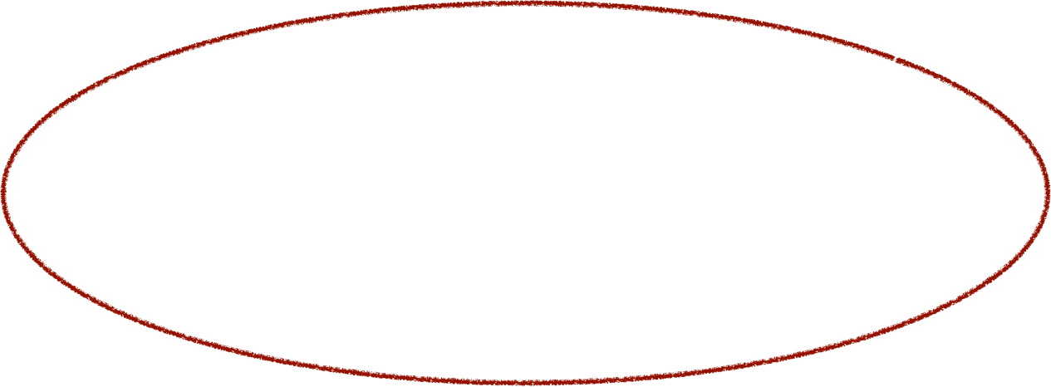
Practice does makes perfect
}
Techniques
+ Tools
Confidence
Adaptability
+ Practice

Slide 11

Your mission

